Slide 1
Project 40: Call For Code
“Project Hermes”
Advisors: Dr. Diane Rover and Dr. Nicholas Fila
Project Influence: IBM Call For Code Competition
Notes:
David
Story of Hermes

Slide 2
Our Team
David Boschwitz
Team Lead
Austin Keen
Graphic Design Lead
Logan Fladung
Subject Matter Expert
Justin Kaufer
User Research & Test Lead
Robert Schedler
Globalization Expert
Caleb Nash
Lead Frontend
Notes:
Everyone

Slide 3
Problem Statement
Problem
asdfasdfasdfasdfasdfasdfasdfasd
Solution
Goal
Natural disasters are becoming more prevalent
Providing relief is becoming more necessary
Design a tool to aid users impacted by natural disasters
Create functionality by mirroring what users need
Notes:
Caleb
Problem: With natural disasters becoming increasingly more common, ways to provide relief to those victims is becoming more and more necessary
Goal: The goal of call for code is to design a tool to improve preparedness for natural disasters and relief to safeguard the health and wellbeing of communities in disaster stricken areas

Slide 4
Market Survey
What makes our project unique?
Expert Interviews with Red Cross employees
Identified users’ essential needs
Emergency toolbox that shows up to date information
Road closures
Red Cross locations
Supplies
Allows for device communication even if there is no cellular or data coverage
Analyzed other emergency applications
None utilized ad hoc network
Notes:
Logan
Add fema/red cross
Change background formatting
Change colors
No colon
No punctuation

Slide 5
Functional Requirements
Provide users with locations of relief support
Mark roads that are unsafe and not allow routes through them
Track users and reroute paths based on traffic along popular routes
Work across iOS and Android platforms
Allow users to send emergency pings to relief workers
Notes:
Bobby
Add icons for all or remove
Add images to each block

Slide 6
Functional Requirements cont.
Function without internet and cellular connections through an ad hoc communication process
Allow users to communicate with each other via chat messaging
Have different types of users including relief worker, ordinary user, and admin
Provide constant news updates based off local settings
Notes:
Bobby

Slide 7
Functional Requirements
Work across iOS and Android platforms
Function without internet and cellular connections through an ad hoc
Provide users with locations of relief support
Provide constant news updates based off local settings
Allow users to communicate with each other via chat messaging
Notes:
Bobby

Slide 8
Non-functional Requirements Overview
Security
Performance
Usability
Scalability
Secure sign-in of authenticated users cannot be duped.
100% of messages will be encrypted
Users experience short response time, within 3 seconds from their request
High availability of our system with above 99% uptime
Ease of usability, the interface is easy to learn and navigate
Application should work with or without network connectivity
Ability to maintain performance and operation from not only concentrated local areas but to more distributed geographic regions
Ability to add new features and deploy rapidly
Notes:
Bobby
**Shorten and make consistent
Usability -> scalability -> performance -> security

Slide 9
Non-functional Requirements Overview
Usability
Scalability
Performance
Security
Interface is easy to learn and navigate
Application works with or without network connectivity
Ability to maintain performance as more users use app
Ability to add new capabilities and deploy rapidly
Users experience short response time from server
High availability of our system with above 99% uptime
Secure sign-in of authenticated users
All messages are encrypted
Notes:
Bobby
**Shorten and make consistent
Usability -> scalability -> performance -> security

Slide 10
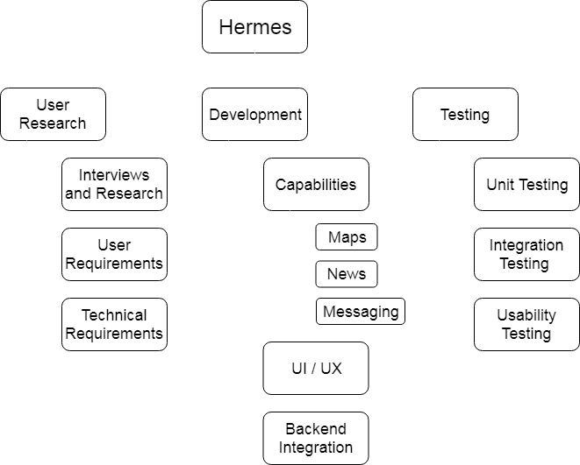
Project Structure
Notes:
Caleb
Three categories we spent the most time

Slide 11
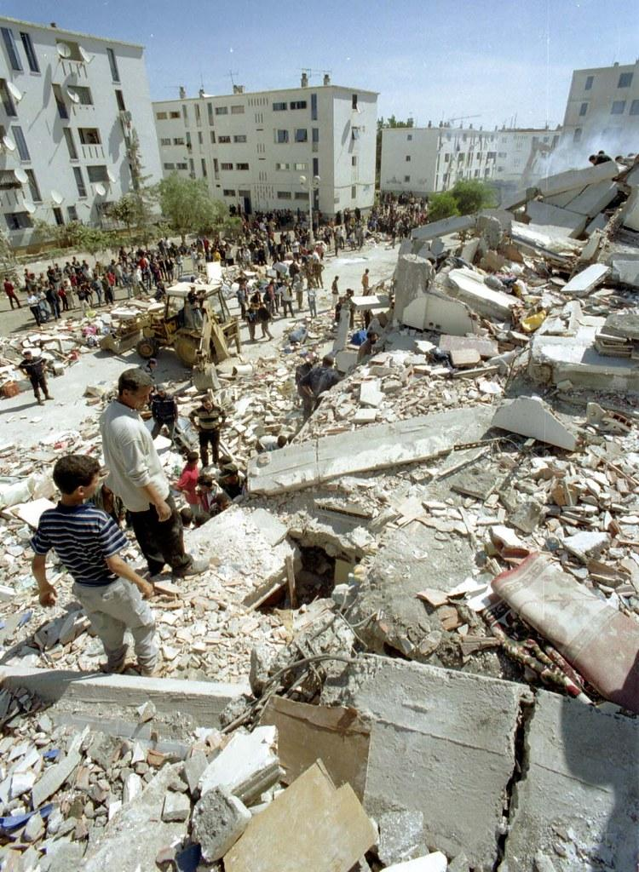
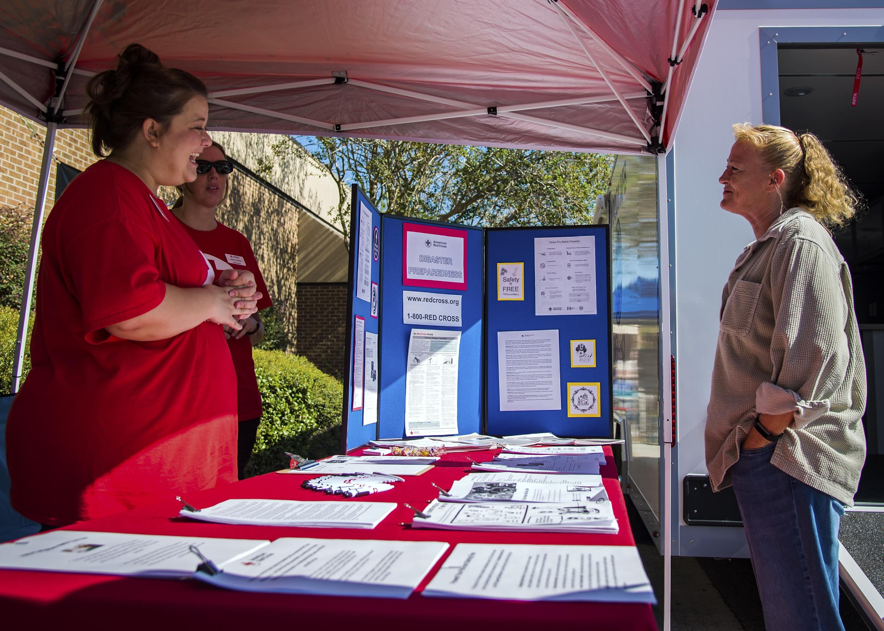
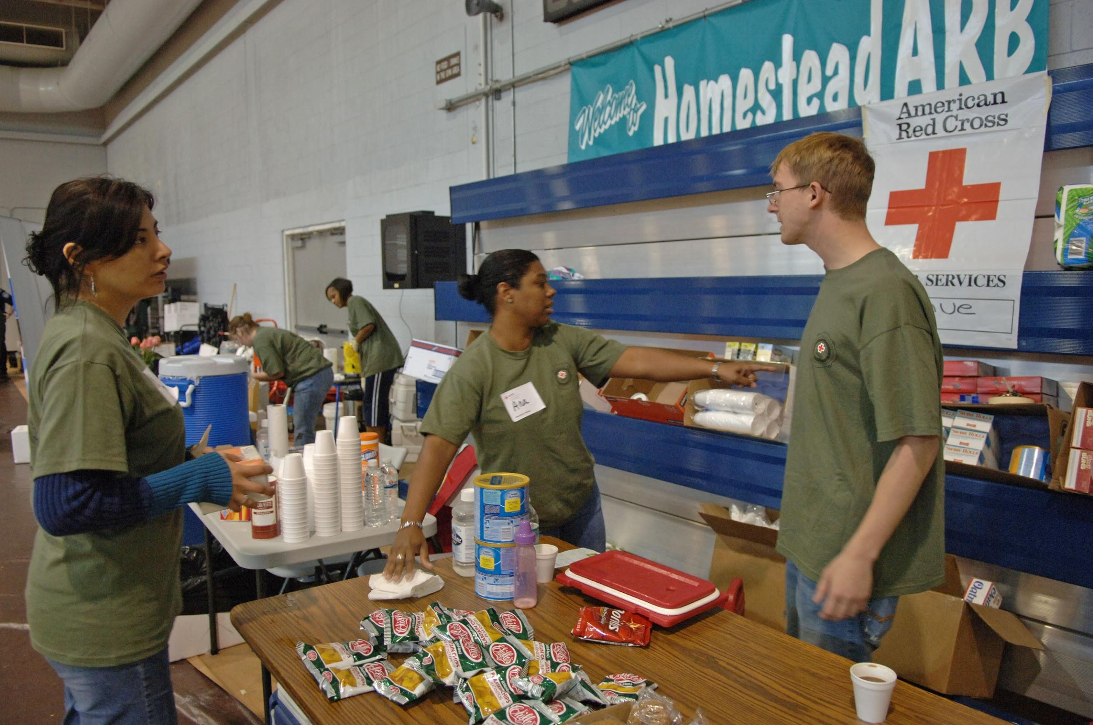
Designing With Empathy
Discovery
Immersion
Connection
Detachment
Notes:
Austin

Slide 12
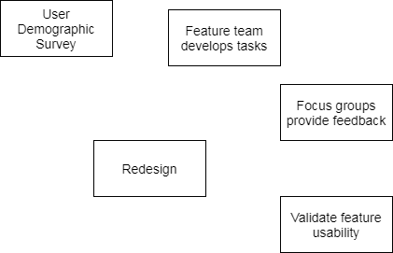
Iterative User Experience Design Process
Weekly UX Meetings
Met with Dr. Nick Fila to discuss UX focus group results
Developed measures for updating UI
User Focus Groups
Gathered information tailored to the current UX iteration
Notes:
Austin
Update text in graphic
Update ‘validate feature usability’ -> ‘release’

Slide 13
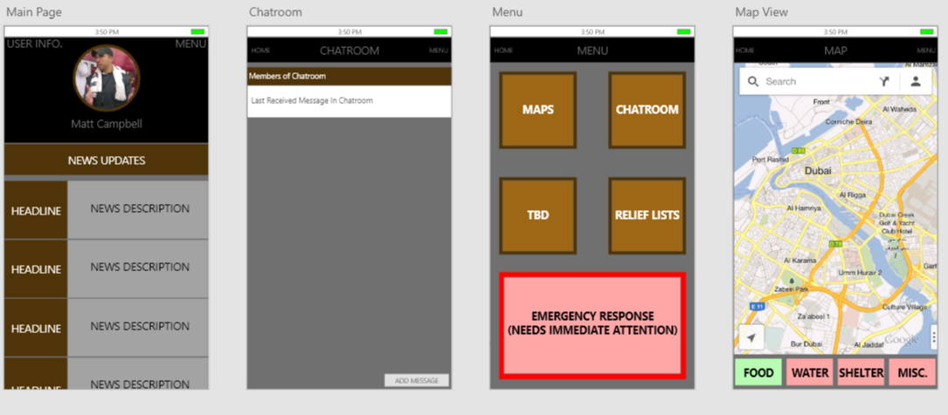
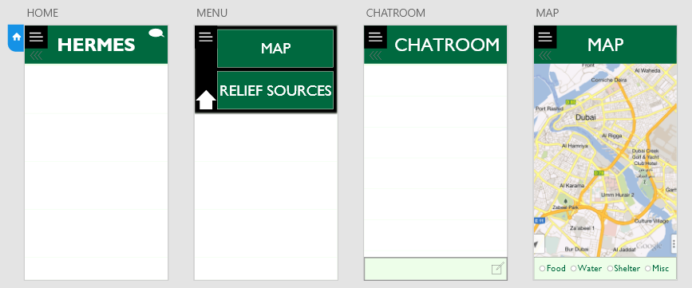
Detailed Design
Notes:
Austin

Slide 14
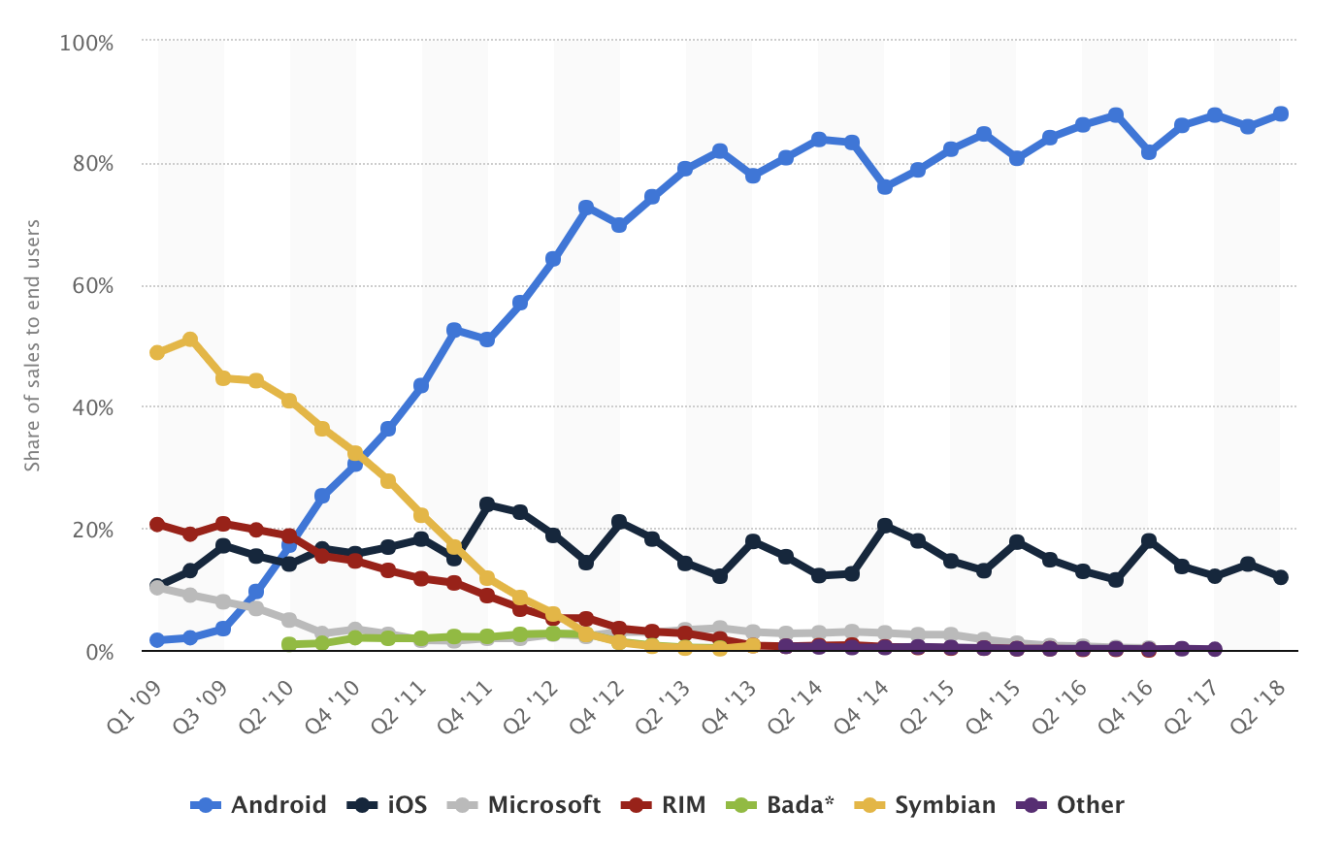
Technical Considerations
Android market share is approaching 90% as developing countries cell phone numbers increase
High focus on Android development.
Cross-platform development would approach 100% of market share
Implementation to iOS in future.
Large focus on user friendly design
Notes:
Logan
**enlarge graph

Slide 15
Technology Platforms Used
Android or iOS devices
Xamarin library
C#
.NET Standard
Autofac dependency injection
Resources.resx
SQLite for database
Newtonsoft.JSON.Net
Google maps API
NUnit
Notes:
David
More meaningful images/graphs

Slide 16
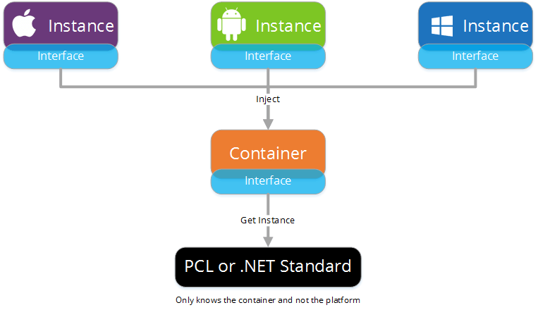
Basic Building Block
Implementations
Dependency Injection
(Autofac)
Reduce coupling of concrete types from code that utilizes that type
Injects the rules of interface into the instance
Mock components for simulation
Capability Decomposition
Broken down into individual projects
Allowed for feature teams
Independent deployment for continuous development
Notes:
David

Slide 17
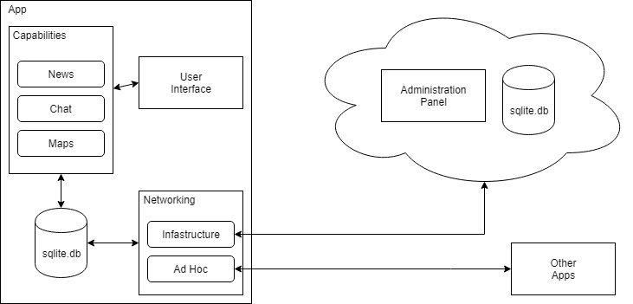
High Level Conceptual Sketch
Ad Hoc
Notes:
David

Slide 18
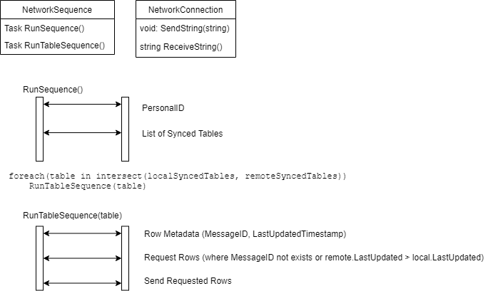
Networking Overview
Notes:
David

Slide 19
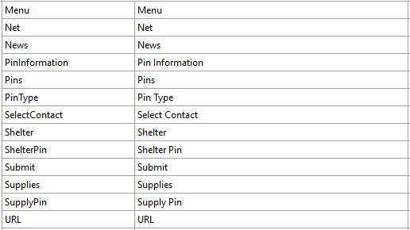
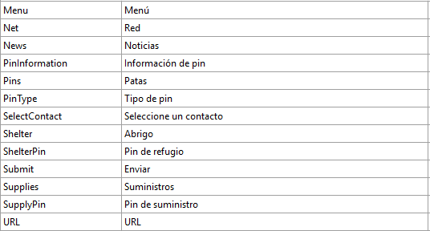
Translation using Application Resource File (.resx)
Easy Translation
Human translator simply translates an excel like spreadsheet
Defined at compile time
Automatically selects language defined by phone’s settings (If supported)
English
Spanish
Notes:
Bobby
Keep screenshot, but add short demo on the bottom if time allows

Slide 20
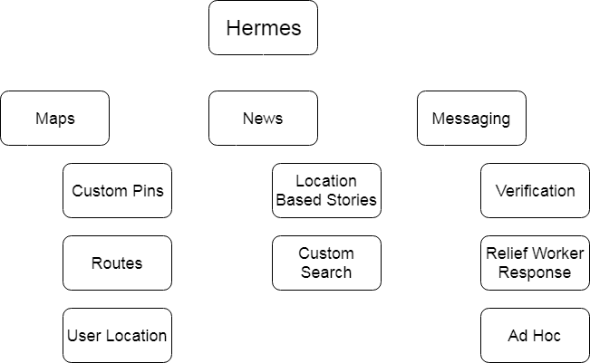
Functional Decomposition

Slide 21
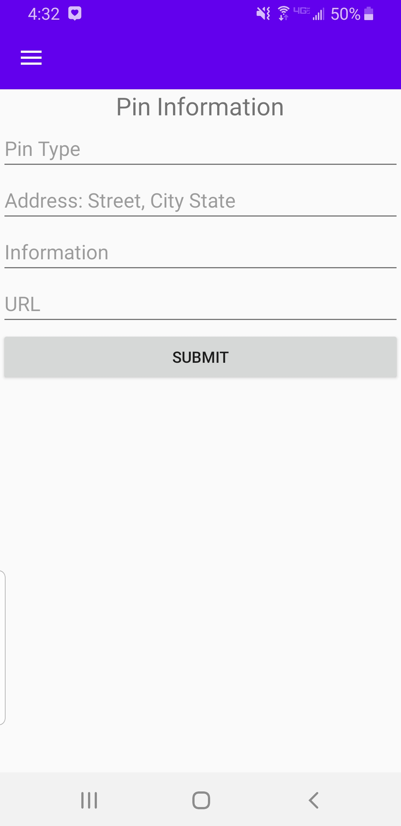
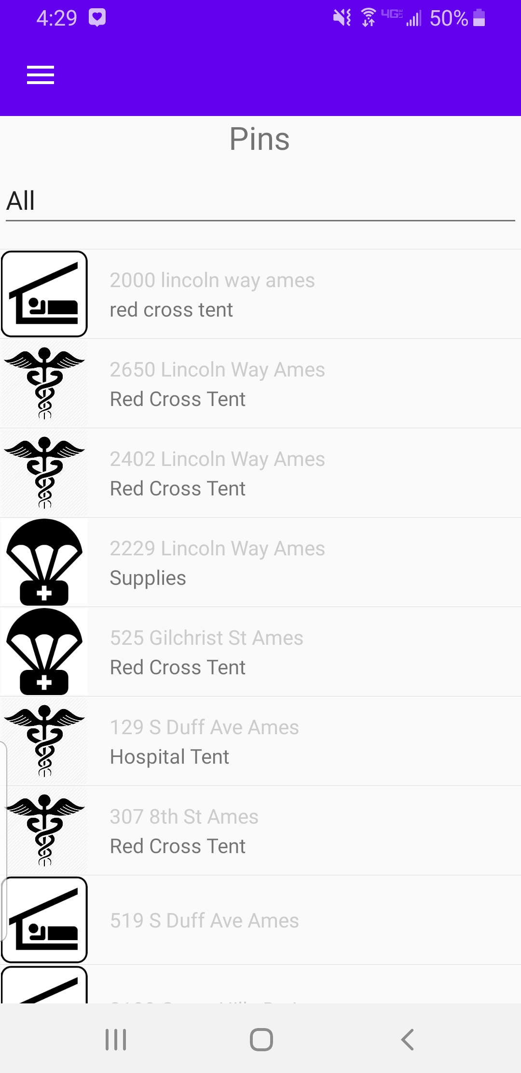
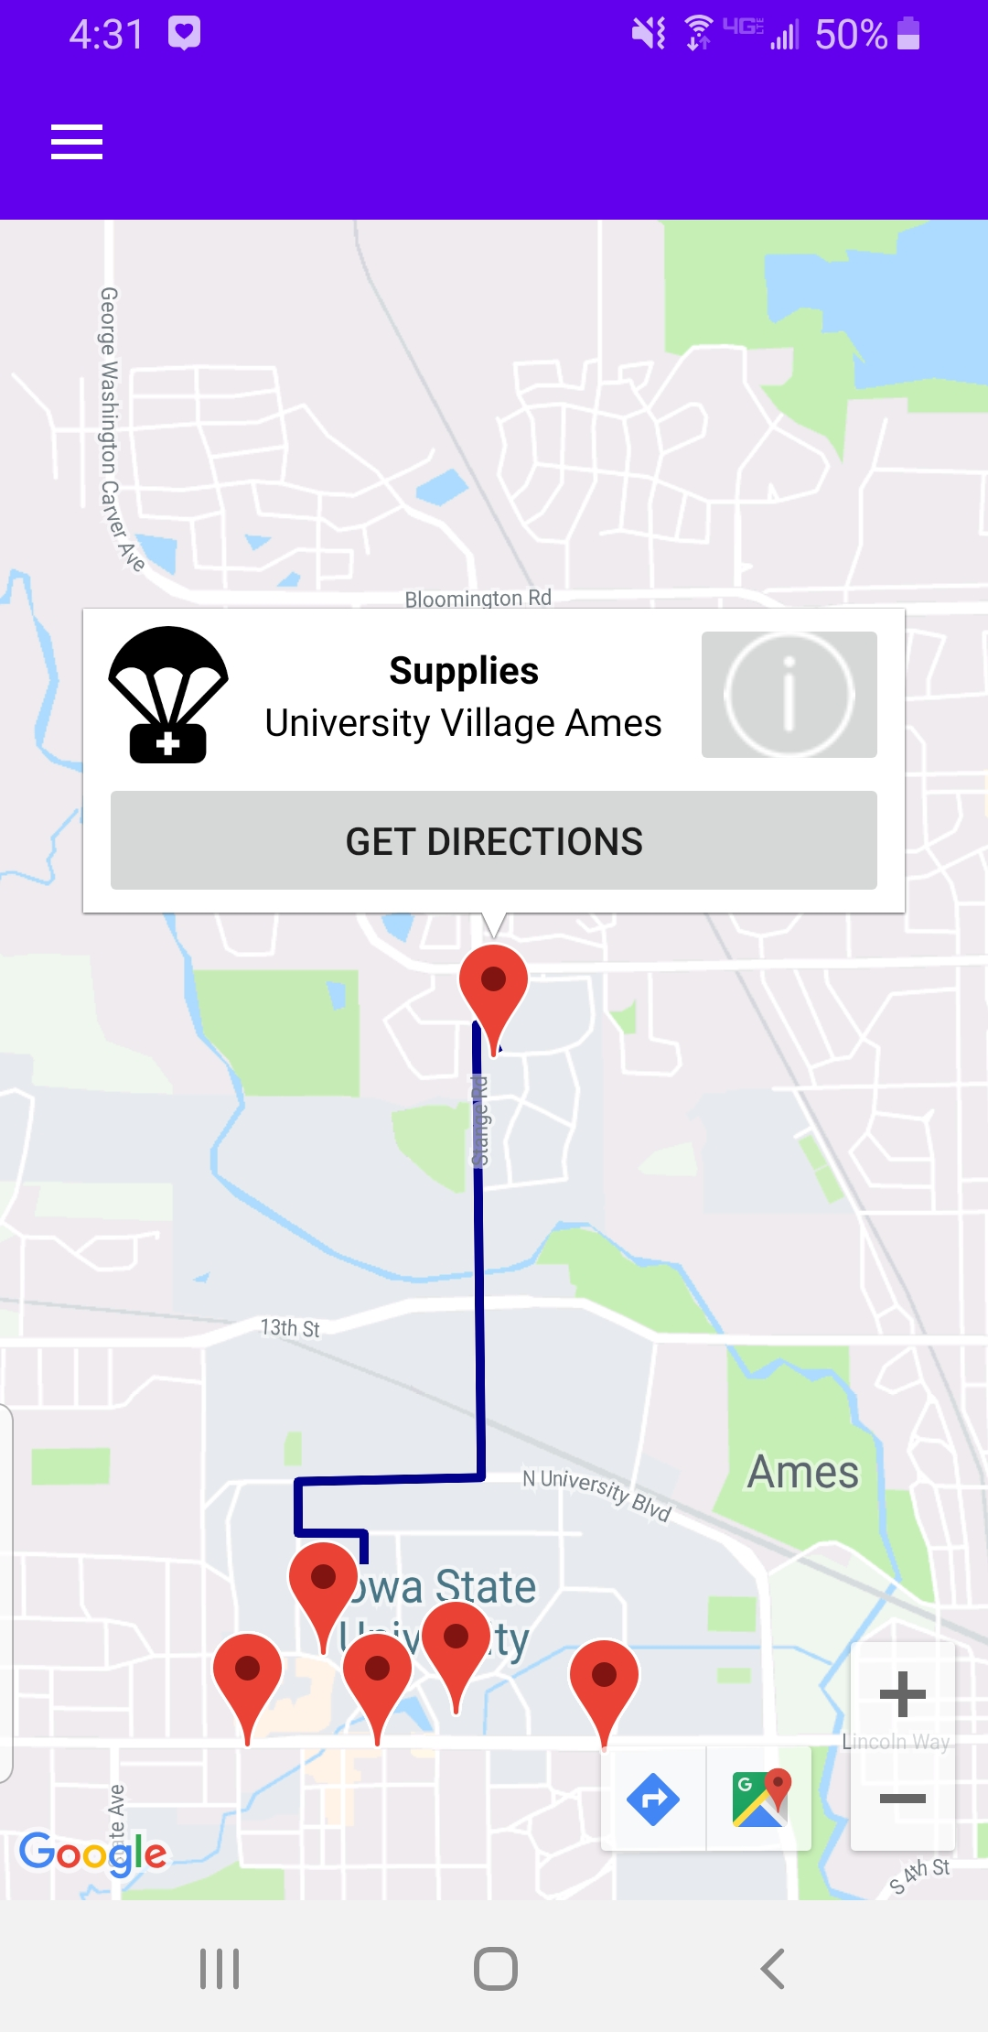
Map Capability
General User
Google Maps API
Implements custom renderer
Fastest route from current location
Two different viewing choices
Administrator
Enter in new relief location information
Verification on map before saving
Notes:
Justin & Nash
DONE

Slide 22
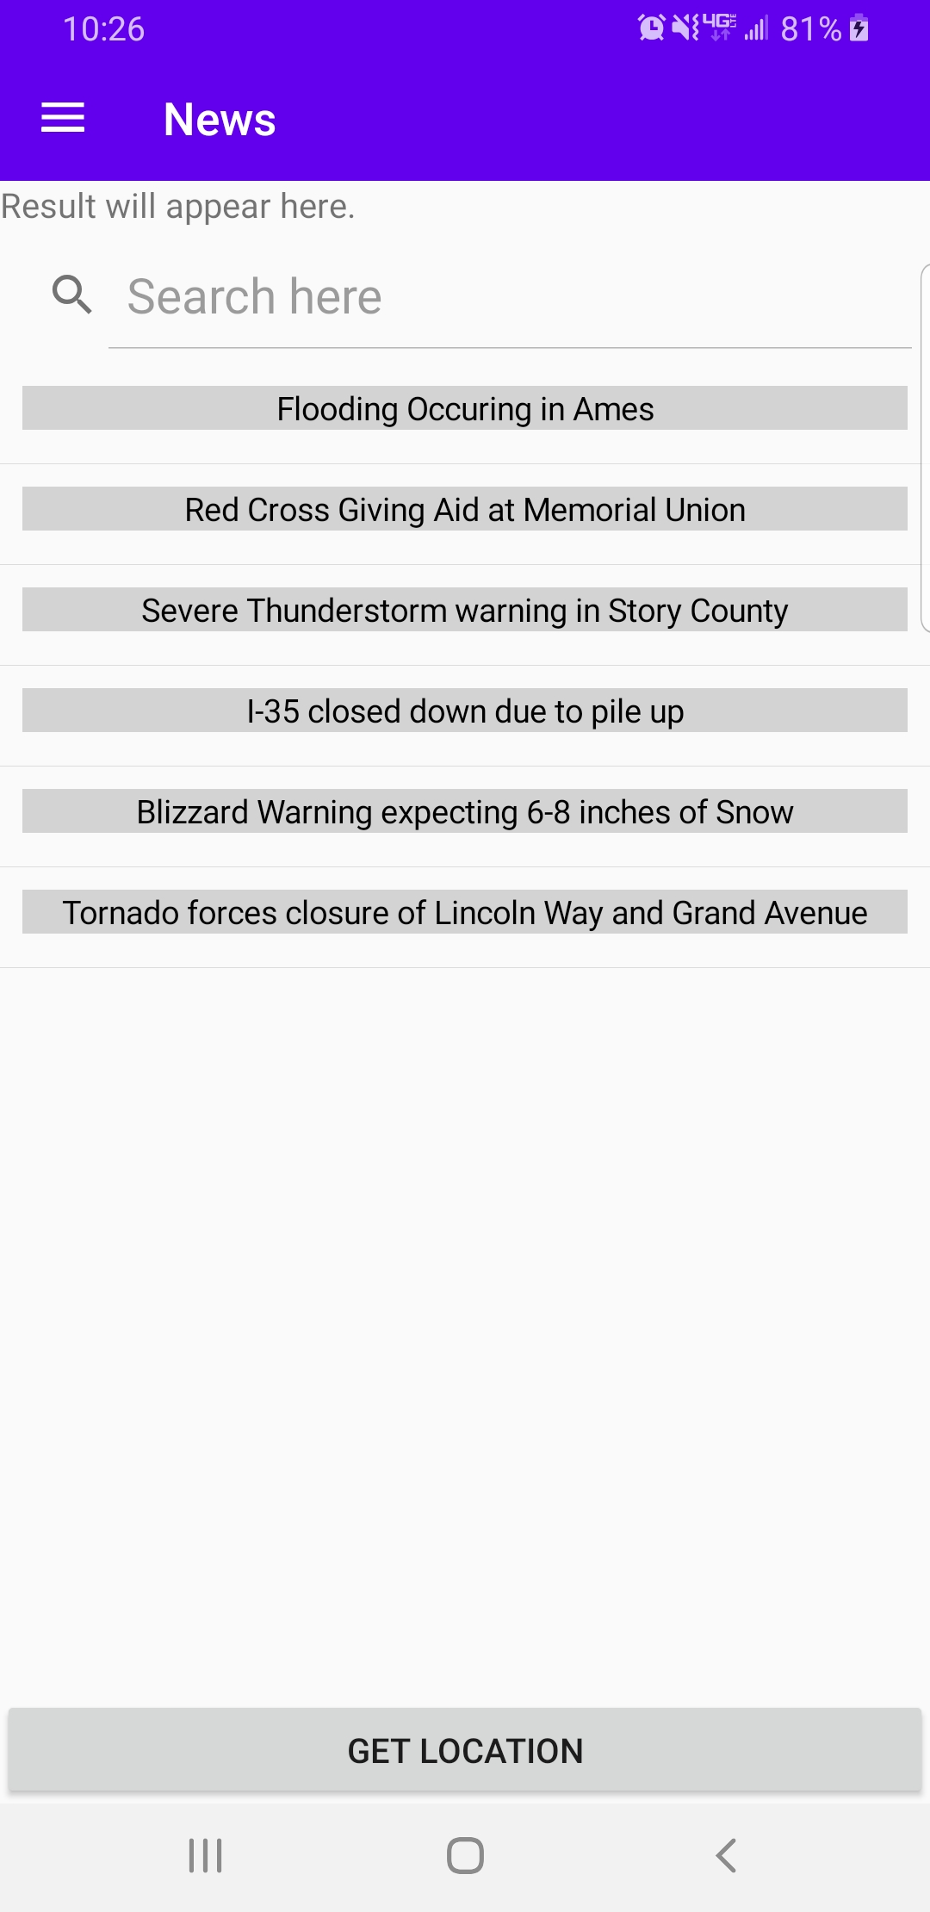
News Capability
General User
News updates based of locational data
Headers expand to full stories when selected
Administrator
Enter in news information related to specific locations
Notes:
Logan

Slide 23
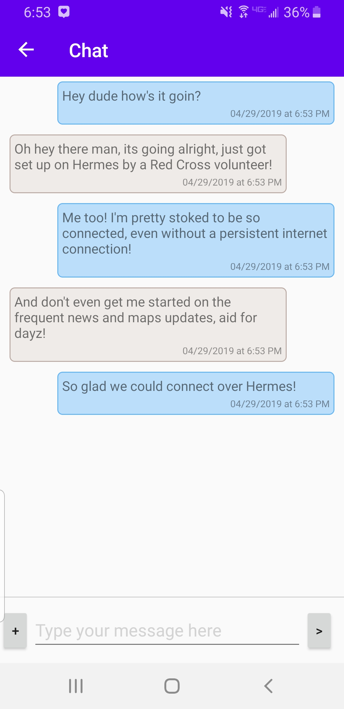
Chat Capability
Verify identity by sending selfie to other users of app
Authentication handshake
Automatically allowed to communicate with Red Cross staff
Ad hoc network allows communication without cellular or data coverage
Notes:
David

Slide 24
Risks & Mitigation
Risk
Mitigation
01
Admin devices hijacked by hackers
Grant command on server is only way to receive access
02
Spread misinformation
Administrators are the only users that have access to saving to the server
03
Similarly, with chat functions and bad users
Authentication between users
Notes:
Bobby

Slide 25
Testing
Unit
Integration
Usability
NUnit
Arrange, Act, Assert
Tested all data structures
Various tests within each component
Interactions between components
Functionality testing for every component upon integration
E.g. navigation to the news feed from the main menu
User demographic survey
Tasks established by feature team
Feedback from users
Redesign / validate feature usability
Notes:
Justin
https://canvas.iastate.edu/courses/58659/discussion_topics/444482

Slide 26
Questions?
Notes:
Everyone

